Slide 1
CSE3501 ISAA (Nasscom) J component
“Image Malware Detection Using Deep Learning”
Pranaydeep Mayank 19BAI1026
Shekhar Iyer 19BAI1055

Slide 2
ABSTRACT
A Malware is a generic term that describes any malicious code or program that can be harmful to systems.
Nowadays, there are countless types of malware attempting to damage companies’ information systems. Thus, it is essential to detect and prevent them to avoid any risk. Malware classification is a widely used task that, as you probably know, can be accomplished by machine learning models quite efficiently.

Slide 3
MALIMG DATASET
We will mainly use the Malimg Dataset which comes from the aforementioned paper.
The Malimg Dataset contains 9339 malware images, belonging to 25 families/classes. Thus, our goal is to perform a multi-class classification of malware.

Slide 4
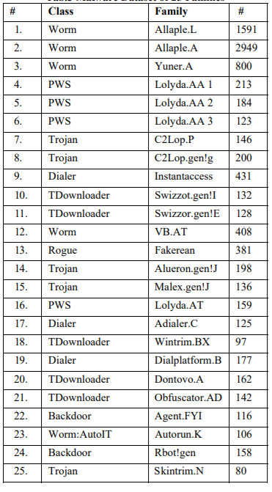
CLASSES in DATASET

Slide 5
Methodology
We will be using deep learning to make the classification.
CNN
CNN with inception model
CNN with Texture filters

